Slide 1
ECE 653 –Machine Learning Security and Privacy
Training a differentially private LSTM model for name classification
Fall 2022
By
Vamshi Gopari
Venkat Nitin Patnala

Slide 2
Outline
Introduction
Applications of LSTM
Existing Approaches
Problem Statement
Implementation
Experimental Results
Limitations
Conclusion

Slide 3
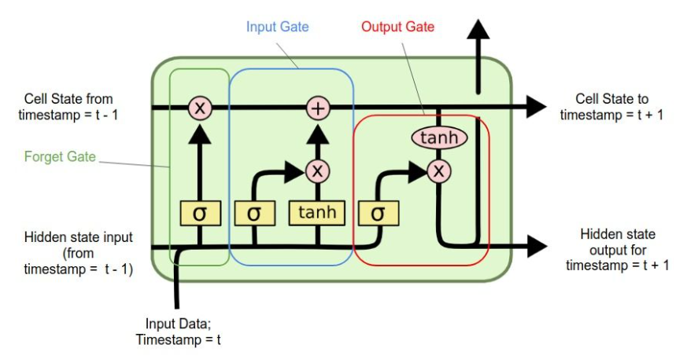
Introduction
Understanding LSTM
Long Short-term Memory has the following states
1) Cell State
2) Hidden State
The general LSTM components are the following
1) Forget gate
2) Input gate
3) Output gate

Slide 4
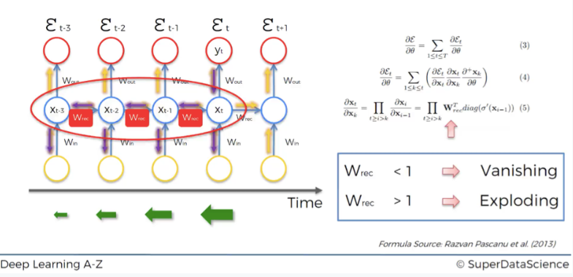
Introduction
Why LSTM?
Understanding vanishing gradient descent

Slide 5
Applications of LSTM
Language modeling
Machine translation
Handwriting recognition
Image captioning
Image generation using attention models
Question answering
Video-to-text conversion
Polymorphic music modeling
Speech synthesis

Slide 6
Existing Approaches
Existing LSTMs
There has implementation of LSTMs using several approaches such as
1) Pytorch
2) Keras
3) CNN
4) Tensorflow

Slide 7
Problem Statement
Although there has been existing LSTM for several applications such as name classification, Handwriting recognition, Video-to-text conversion, etc. There has been collection of various sets of data in LSTM. The privacy of data is always at risk.
So, it is required to include the privacy parameter in the LSTM.

Slide 8
Implementation steps for training differential LSTM for name classifier
Datasets uploading from source
Training/Validation Set preparation
Training/ Evaluation Cycle
Hyper Parameters
Model
Defining the Privacy engine, optimizer and loss criterion for the problem
Training the name classifier with privacy
Training the name classifier without privacy

Slide 9
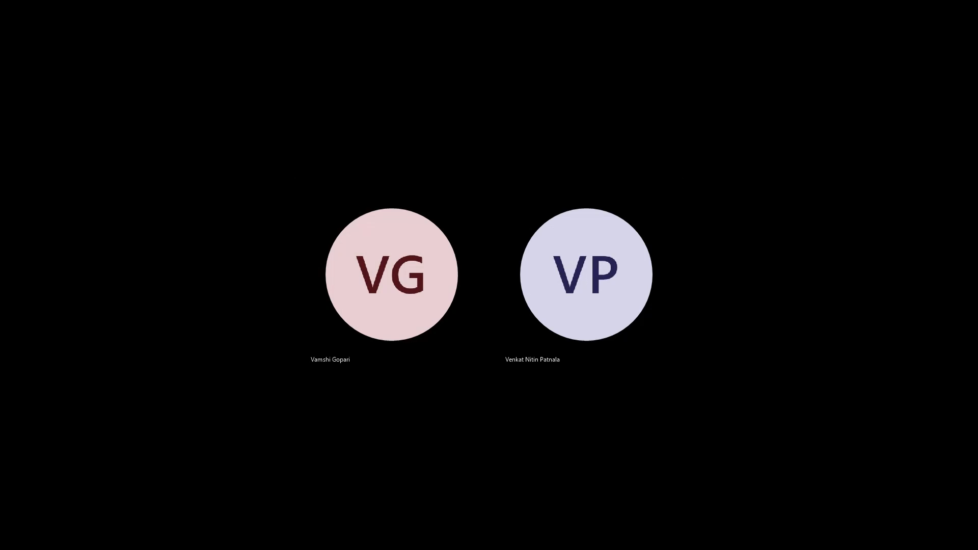
Experimental Results

Slide 10
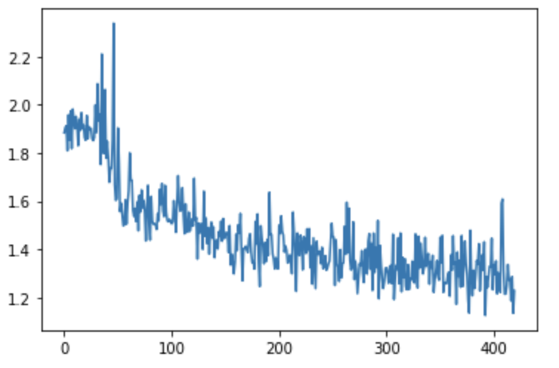
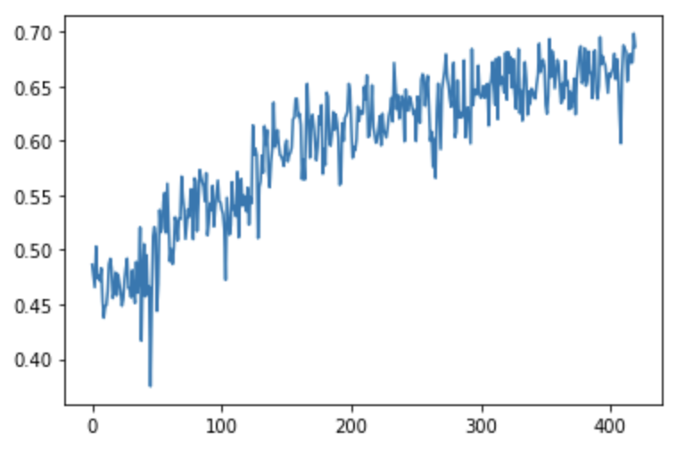
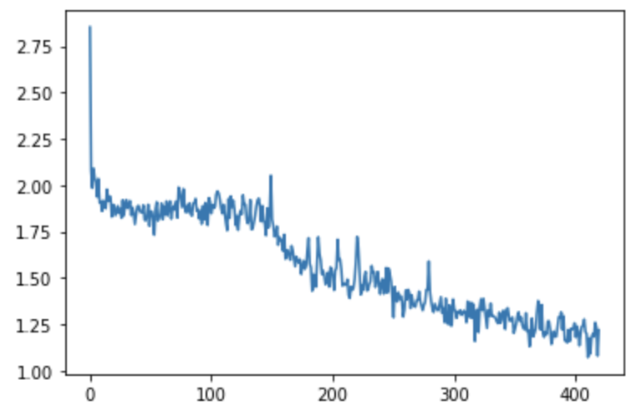
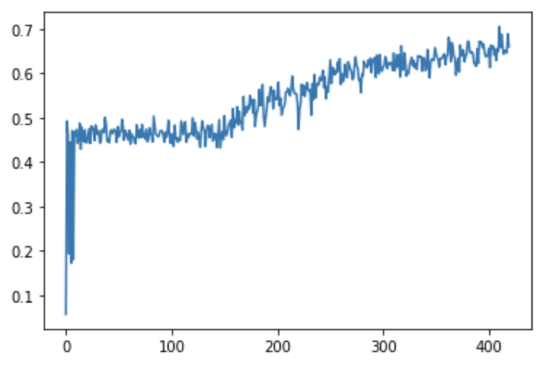
Graphs – Default dataset
Loss with default DPLSTM
Accuracy with default DPLSTM
Accuracy with our default barebone RNN
Loss with our default barebone RNN

Slide 11
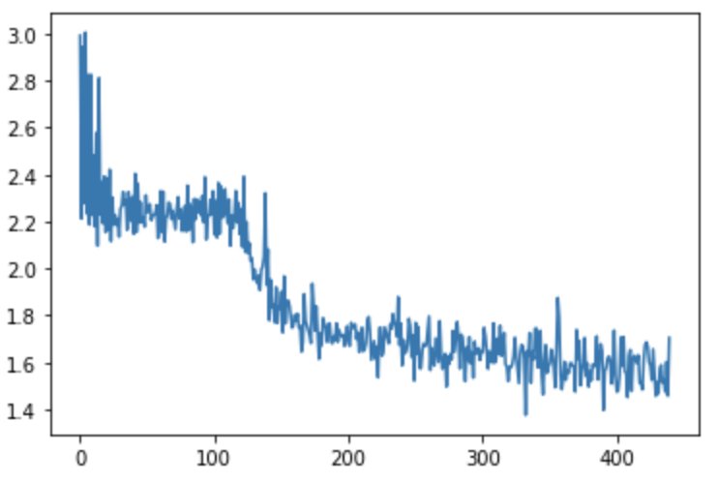
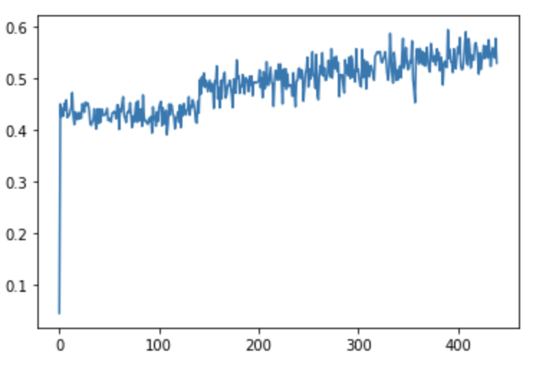
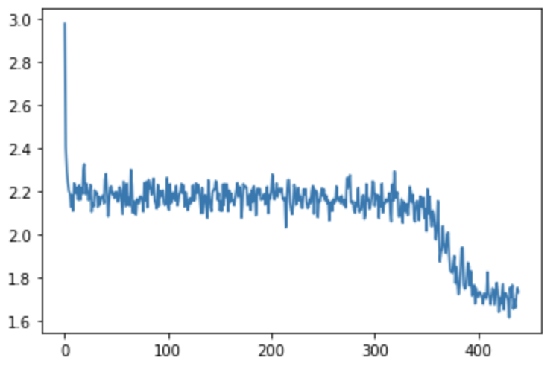
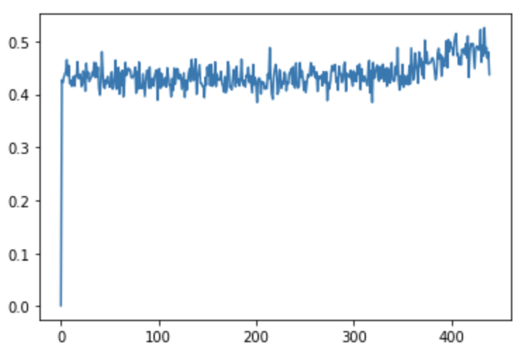
Graphs – Own dataset
Loss with our dataset DPLSTM
Accuracy with our dataset DPLSTM
Loss with our dataset barebone RNN
Accuracy with our dataset barebone RNN

Slide 12
Limitations
In this Project, the main goal is to compare accuracy and loss result of the model networks.
Using the DPLSTM, it is feasible to predict a name as belonging to a specific country, however this was not done in this experiment, since the main goal of this experiment is to compare the results.

Slide 13
Conclusion
In conclusion, we had implemented LSTM name classifier with differential privacy using the existing dataset. Then we created a new dataset and implemented in the same model.
As the main goal was to compare accuracy and loss of the models. The accuracy of the model never decreases with adding differential privacy to it. But time taken for training each epoch for model with differential privacy is more.
The time tradeoff is not considered as the primary objective was to achieve privacy without losing any accuracy.

Slide 14
Thanks !

